Slide 1
Curriculum Vitae
Alejandro Giraldo Herrera

Slide 2
01
02
03
04
Education
Experience
Skills
Hobbies
Here you can read about my education.
Here you can find my work experience.
Here you can know about my skills and abilities.
Here you can learn more about me .

Slide 3
About Me
NAME: Alejandro Giraldo Herrera.
DATE OF BRITH: March/23/2003.
ID: 1004916686.
ADDRES: La Cecilia first stage neighborhood.
MARITAL STATUS: Single
E-MAIL: alejito23001@gmail.com
PHONE NUMBER: 3013258495

Slide 4
01
Education

Slide 5
About Me
Personality
Education
From 2009 to 2013 I studied at Bosques de Pinares elementary school.
From 2014 to 2016 I studied at Laura Vicuña secondary school the sixty and seventh grade.
From 2016 to 2018 I studied at COAMI in Spain the seventh and eighth grade.
From 2019 to 2021 I studied and graduated at Bosques de Pinares secondary school ninth, tenth and eleventh grade
I’m polite.
I’m responsable
I’m tolerant.
I’m respectful.
I’m dedicated.
I’m an introvert person, but i can be funny and friendly.

Slide 6
02
Experience

Slide 7
Experience
2019-2020
2021-2023
N/A
N/A
Assistant in file management at the south Hospital.
Software developer at Rappi.

Slide 8
Software developer
2021-2023
Rappi
I am a technical support of the Rappi’s app.
I develop and improve apps.
I develop and improve web applications.
I have daily meetings to report progress.
I am a database manager.

Slide 9
What Sets Me Apart
Passion
Assertive Comunication
I am passionate about programming and tecnology
I have assertive communication

Slide 10
What Sets Me Apart
Ability to solve problems
Creative
I have a good logical thinking
I am creative and innovative

Slide 11
03
Skills

Slide 12
Communication Skills
Language | Spoken Level | Written Level | Certificate
Spanish | 9/10 | 9/10 | Advanced
English | 5/10 | 7/10 | Intermediate

Slide 13
Technical Skills
80%
50%
90%
70%
Frontend Programing
Assertive Comunication
Good programing habits
Logical

Slide 14
Computer Skills
Design Programs
Software
Web Apps 85%
Mobile Apps 40%
Apps - Office Suits - Design apps - Mathematical Thinking

Slide 15
04
Hobbies

Slide 16
Hobbies
Travel
Listen to music
Walk

Slide 17
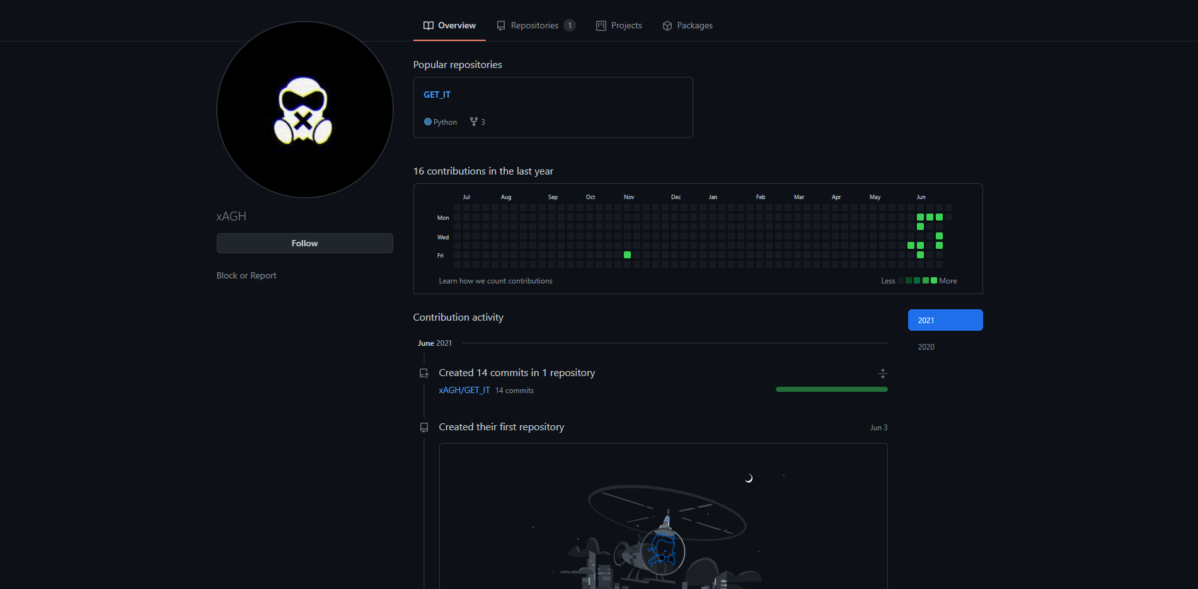
My Personal Web
You can enter https://github.com/xAGH/GET_IT
To know about my works and projects.

Slide 18
Thanks!
Do you have any questions?
alejito23001@gmail.com
+57 3013258495
Alejo Giraldo

